Slide 1

Lecture 06:
Citing Computer Code
CoTaPP: Computational Thinking and
Programming with Python
All icons by: https://www.flaticon.com/

Slide 2

Writing Code
“Writing code is similar to academic writing in that when you use or adapt code developed by someone else as part of your project, you must cite your source.” (Academic Integrity at MIT)
https://integrity.mit.edu/handbook/writing-code#:~:text=When%20should%20I%20cite%20a,should%20still%20credit%20the%20source.

Slide 3
Writing Code
“Writing code is similar to academic writing in that when you use or adapt code developed by someone else as part of your project, you must cite your source.” (Academic Integrity at MIT)
We know that copying code/solutions from other students is wrong
https://integrity.mit.edu/handbook/writing-code#:~:text=When%20should%20I%20cite%20a,should%20still%20credit%20the%20source.

Slide 4
Writing Code
“Writing code is similar to academic writing in that when you use or adapt code developed by someone else as part of your project, you must cite your source.” (Academic Integrity at MIT)
We know that copying code/solutions from other students is wrong
But, the rules/cases for using/adapting code from other people (not peers) is not always that clear
https://integrity.mit.edu/handbook/writing-code#:~:text=When%20should%20I%20cite%20a,should%20still%20credit%20the%20source.

Slide 5
Activity
Discuss with your neighbors cases
  when is necessary to cite code
  when is NOT necessary to cite code
Write your cases in Wooclap
  next wooclap
Time: 10 min

Slide 6
Citing Code
General idea
  to some else, it should be clear what is your original contribution and what is based on other people’s contributions

Slide 7
Rule of thumb
Don’t cite:
  General patterns: if there is only one way to program a specific task and this is so commonly used then it may not need to be cited
    E.g., a "hello world" program, create a new window, read a column using Pandas, creating a infinite loop, etc.
https://integrity.mit.edu/handbook/writing-code#:~:text=When%20should%20I%20cite%20a,should%20still%20credit%20the%20source.

Slide 8
Rule of thumb
Don’t cite:
  General patterns: if there is only one way to program a specific task and this is so commonly used then it may not need to be cited
    E.g., a "hello world" program, create a new window, read a column using Pandas, creating a infinite loop, etc.
Cite:
  when copy code from an external source
  when copy the code and adapt it
https://integrity.mit.edu/handbook/writing-code#:~:text=When%20should%20I%20cite%20a,should%20still%20credit%20the%20source.

Slide 9
Rule of thumb
Don’t cite:
  General patterns: if there is only one way to program a specific task and this is so commonly used then it may not need to be cited
    E.g., a "hello world" program, create a new window, read a column using Pandas, creating a infinite loop, etc.
Cite:
  when copy code from an external source
  when copy the code and adapt it
Follow the license. If there is no license, assume it has copyright
https://integrity.mit.edu/handbook/writing-code#:~:text=When%20should%20I%20cite%20a,should%20still%20credit%20the%20source.

Slide 10
Example (appropriate)
/**
* A utility class that gives applets the ability to detect proxy host settings.
* This was adapted from a post from Chris Forster on 20030227 to a Sun Java
* forum here:
* http://forum.java.sun.com/thread.jspa?threadID=364342&tstart=120
*/
<CODE>
Source: https://integrity.mit.edu/handbook/writing-code#:~:text=When%20should%20I%20cite%20a,should%20still%20credit%20the%20source.

Slide 11
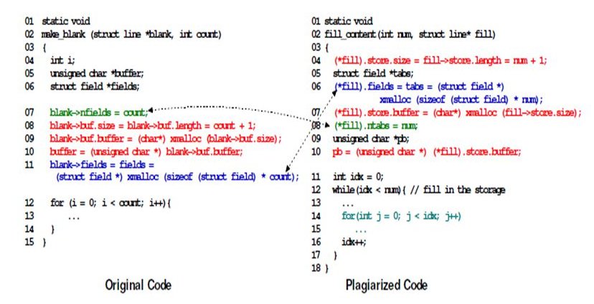
Example (inappropriate)
Source: https://codequiry.com/code-plagiarism#:~:text=Some%20Examples%20Of%20Code%20Plagiarism&text=This%20is%20when%20a%20student,common%20trend%20in%20the%20classroom.

Slide 12
Citing Code: Resources
https://lib.pstcc.edu/csplagiarism/citation
https://integrity.mit.edu/handbook/writing-code#:~:text=When%20should%20I%20cite%20a,should%20still%20credit%20the%20source.

Slide 13
Can I use external code if I cite it?
https://integrity.mit.edu/handbook/writing-code#:~:text=When%20should%20I%20cite%20a,should%20still%20credit%20the%20source.

Slide 14
Purpose of evaluation
Evaluations/Assignments want to measure your:
  Knowledge
  Creativity
  Capacity to solve a problem
  Etc.
If you copy a solution from Stack Overflow/Generative AI:
  We are not evaluating your knowledge, creativity, capacity, etc.
  We are evaluating your ability to use those tools and their accuracy.
https://integrity.mit.edu/handbook/writing-code#:~:text=When%20should%20I%20cite%20a,should%20still%20credit%20the%20source.

Slide 15
Can I use external code if I cite it?
If you find a code/solution for something that is not what is being evaluated:
  External sources could be used (if cited):
    “you need to do all the implementation by yourself”
    “you cannot use external libraries for the calculations …”
    “you can use any library/solution for the display of reports”
  Better to ask
https://integrity.mit.edu/handbook/writing-code#:~:text=When%20should%20I%20cite%20a,should%20still%20credit%20the%20source.

